Slide 1
Exception Handling in Java
Exception Handling in Java :
The Exception Handling in Java is one of the powerful mechanism to handle the runtime errors so that normal flow of the application can be maintained.
What is Exception in Java ?
In Java, an exception is an event that disrupts the normal flow of the program. It is an object which is thrown at runtime.

Slide 2
Exception Handling in Java
What is Exception Handling ?
Exception Handling is a mechanism to handle runtime errors such as ClassNotFound, IO, SQL, Remote etc.
Advantage of Exception Handling
The core advantage of exception handling is to maintain the normal flow of the application. An exception normally disrupts the normal flow of the application that is why we use exception handling. Let's take a scenario:

Slide 3
Exception Handling in Java
Exception Handling Example
statement 1;
statement 2;
statement 3;
statement 4;
statement 5;//exception occurs
statement 6;
statement 7;
statement 8;
statement 9;
statement 10;

Slide 4
Exception Handling in Java
Exception Handling Example
Suppose there are 10 statements in your program and there occurs an exception at statement 5, the rest of the code will not be executed i.e. statement 6 to 10 will not be executed. If we perform exception handling, the rest of the statement will be executed. That is why we use exception handling in Java.

Slide 5
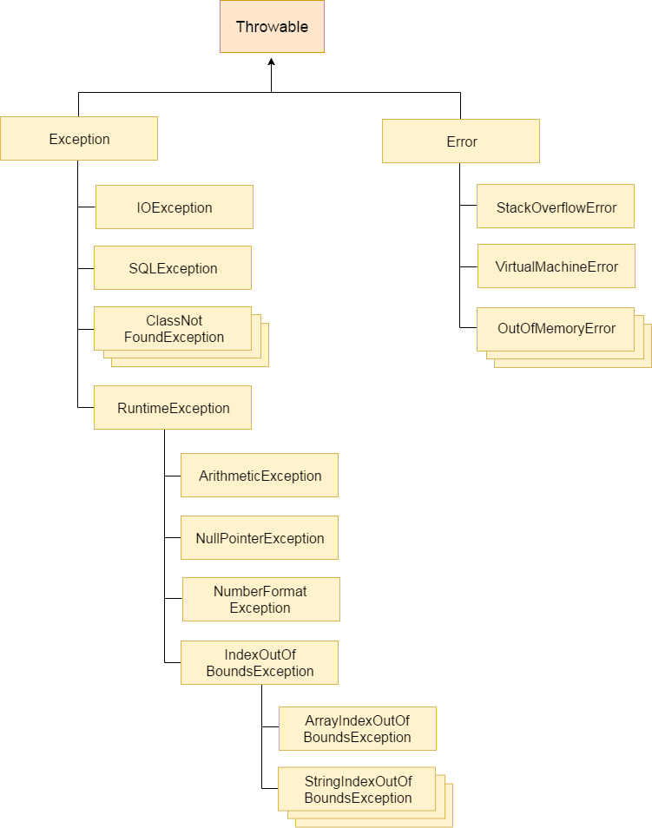
Exception Handling in Java
Hierarchy of Java Exception classes :

Slide 6
Exception Handling in Java
Types of Java Exceptions :
There are mainly two types of exceptions: checked and unchecked. Here, an error is considered as the unchecked exception. According to Oracle, there are three types of exceptions:
Checked Exception
Unchecked Exception
Error

Slide 7
Exception Handling in Java
Difference between Checked and Unchecked Exceptions
1) Checked Exception :
The classes which directly inherit Throwable class except RuntimeException and Error are known as checked exceptions e.g. IOException, SQLException etc. Checked exceptions are checked at compile-time.
2) Unchecked Exception :
The classes which inherit RuntimeException are known as unchecked exceptions e.g. ArithmeticException, NullPointerException, ArrayIndexOutOfBoundsException etc. Unchecked exceptions are not checked at compile-time, but they are checked at runtime.

Slide 8
Exception Handling in Java
Difference between Checked and Unchecked Exceptions
3) Error :
Error is irrecoverable e.g. OutOfMemoryError, VirtualMachineError, AssertionError etc.

Slide 9
Exception Handling in Java
Java Exception Keywords :
Keyword | Description
try | The "try" keyword is used to specify a block where we should place exception code. The try block must be followed by either catch or finally. It means, we can't use try block alone.
catch | The "catch" block is used to handle the exception. It must be preceded by try block which means we can't use catch block alone. It can be followed by finally block later.
finally | The "finally" block is used to execute the important code of the program. It is executed whether an exception is handled or not.
throw | The "throw" keyword is used to throw an exception.
throws | The "throws" keyword is used to declare exceptions. It doesn't throw an exception. It specifies that there may occur an exception in the method. It is always used with method signature.

Slide 10
Exception Handling in Java
Java Exception Handling Example
public class JavaExceptionExample{
public static void main(String args[]){
try{
//code that may raise exception
int data=100/0;
}catch(ArithmeticException e){System.out.println(e);}
//rest code of the program
System.out.println("rest of the code...");
}
}
Output:
Exception in thread main java.lang.ArithmeticException:/ by zero
rest of the code...

Slide 11
Exception Handling in Java
Common Scenarios of Java Exceptions :
There are given some scenarios where unchecked exceptions may occur. They are as follows:
1) A scenario where ArithmeticException occurs
If we divide any number by zero, there occurs an ArithmeticException.
int a=50/0;//ArithmeticException

Slide 12
Exception Handling in Java
Common Scenarios of Java Exceptions :
2) A scenario where NullPointerException occurs
If we have a null value in any variable, performing any operation on the variable throws a NullPointerException.
String s=null;
System.out.println(s.length());//NullPointerException

Slide 13
Exception Handling in Java
Common Scenarios of Java Exceptions :
3) A scenario where NumberFormatException occurs
The wrong formatting of any value may occur NumberFormatException. Suppose I have a string variable that has characters, converting this variable into digit will occur NumberFormatException.
String s="abc";
int i=Integer.parseInt(s);//NumberFormatException

Slide 14
Exception Handling in Java
Common Scenarios of Java Exceptions :
4) A scenario where ArrayIndexOutOfBoundsException occurs
If you are inserting any value in the wrong index, it would result in ArrayIndexOutOfBoundsException as shown below:
int a[]=new int[5];
a[10]=50; //ArrayIndexOutOfBoundsException

Slide 15
Exception Handling in Java
Java try-catch :
Java try block :
Java try block is used to enclose the code that might throw an exception. It must be used within the method.
Java try block must be followed by either catch or finally block.
Syntax of java try-catch
try{
//code that may throw exception
}catch(Exception_class_Name ref){}

Slide 16
Exception Handling in Java
Syntax of try-finally block
try{
//code that may throw exception
}finally{}
Java catch block :
Java catch block is used to handle the Exception. It must be used after the try block only.
You can use multiple catch block with a single try.

Slide 17
Exception Handling in Java
Problem without exception handling :
public class Testtrycatch1{
public static void main(String args[]){
int data=50/0;//may throw exception
System.out.println("rest of the code...");
}
}
Output:
Exception in thread main java.lang.ArithmeticException:/ by zero

Slide 18
Exception Handling in Java
Solution by exception handling :
public class Testtrycatch2{
public static void main(String args[]){
try{
int data=50/0;
}catch(ArithmeticException e)
{System.out.println(e);}
System.out.println("rest of the code...");
}}
Output:
Exception in thread main java.lang.ArithmeticException:/ by zero
rest of the code...

Slide 19
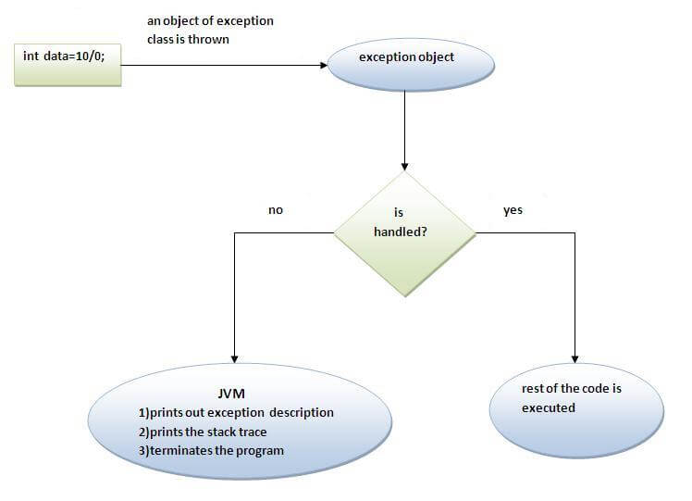
Exception Handling in Java
Internal working of java try-catch block :

Slide 20
Exception Handling in Java
Java Multi catch block :
public class TestMultipleCatchBlock{
public static void main(String args[]){
try{
int a[]=new int[5];
a[5]=30/0; }
catch(ArithmeticException e)
{System.out.println("task1 is completed");}
catch(ArrayIndexOutOfBoundsException e) {System.out.println("task 2 completed");}
catch(Exception e)
{System.out.println("common task completed");}
System.out.println("rest of the code..."); }}

Slide 21
Exception Handling in Java
Java Multi catch block :
Output:task1 completed
rest of the code...
Rule: At a time only one Exception is occured and at a time only one catch block is executed.
Rule: All catch blocks must be ordered from most specific to most general i.e. catch for ArithmeticException must come before catch for Exception .

Slide 22
Exception Handling in Java
Java Multi catch block :
class TestMultipleCatchBlock1
{
public static void main(String args[])
{
try
{
int a[]=new int[5];
a[5]=30/0;
}

Slide 23
Exception Handling in Java
Java Multi catch block :
catch(Exception e)
{System.out.println("common task completed");}
catch(ArithmeticException e)
{System.out.println("task1 is completed");}
catch(ArrayIndexOutOfBoundsException e) {System.out.println("task 2 completed");}
System.out.println("rest of the code..."); } }
Output:
Compile-time error

Slide 24
Exception Handling in Java
Java Nested try block :
The try block within a try block is known as nested try block in java.
Why use nested try block ?
Sometimes a situation may arise where a part of a block may cause one error and the entire block itself may cause another error. In such cases, exception handlers have to be nested.

Slide 25
Exception Handling in Java
Syntax:
....
try
{
statement 1;
try
{ statement 1; }
catch(Exception e)
{ }
}
catch(Exception e)
{ }
....

Slide 26
Exception Handling in Java
Java nested try example :
class Excep6{
public static void main(String args[]){
try{
try{
System.out.println("going to divide");
int b =39/0;
}catch(ArithmeticException e){System.out.println(e);}

Slide 27
Exception Handling in Java
Java nested try example :
try{
int a[]=new int[5];
a[5]=4;
}catch(ArrayIndexOutOfBoundsException e){System.out.println(e);}
System.out.println("other statement);
}catch(Exception e){System.out.println("handeled");}
System.out.println("normal flow..");
}
}

Slide 28
Exception Handling in Java
Java finally block :
Java finally block is a block that is used to execute important code such as closing connection, stream etc.
Java finally block is always executed whether exception is handled or not.
Java finally block follows try or catch block.

Slide 29
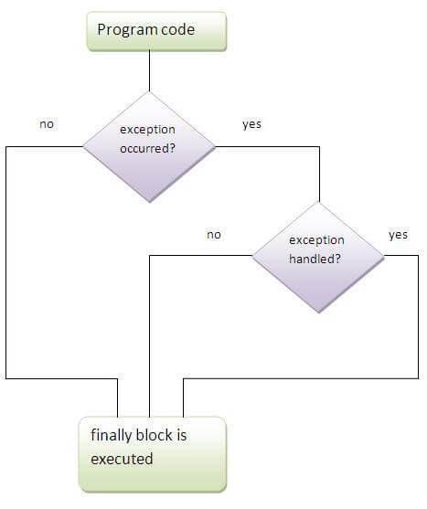
Exception Handling in Java
Java finally block :
Note: If you don't handle exception, before terminating the program, JVM executes finally block(if any).

Slide 30
Exception Handling in Java
Why use java finally ?
Finally block in java can be used to put "cleanup" code such as closing a file, closing connection etc.
Usage of Java finally :
class TestFinallyBlock{
public static void main(String args[]){
try{
int data=25/5;
System.out.println(data);
}

Slide 31
Exception Handling in Java
Usage of Java finally :
catch(NullPointerException e)
{System.out.println(e);}
finally
{System.out.println("finally block is always executed");}
System.out.println("rest of the code...");
}
}
Output: 5
finally block is always executed
rest of the code...

Slide 32
Exception Handling in Java
Usage of Java finally :
class TestFinallyBlock1{
public static void main(String args[]){
try{
int data=25/0;
System.out.println(data);
}
catch(NullPointerException e){System.out.println(e);} finally{System.out.println("finally block is always executed");}
System.out.println("rest of the code...");
} }
Output:finally block is always executed
Exception in thread main java.lang.ArithmeticException:/ by zero

Slide 33
Exception Handling in Java
Usage of Java finally :
public class TestFinallyBlock2{
public static void main(String args[]){
try{
int data=25/0;
System.out.println(data);
}
catch(ArithmeticException e){System.out.println(e);}
finally{System.out.println("finally block is always executed");}
System.out.println("rest of the code...");
}
}

Slide 34
Exception Handling in Java
Usage of Java finally :
Output:
Exception in thread main java.lang.ArithmeticException:/ by zero
finally block is always executed
rest of the code...
Rule: For each try block there can be zero or more catch blocks, but only one finally block.
Note: The finally block will not be executed if program exits(either by calling System.exit() or by causing a fatal error that causes the process to abort).

Slide 35
Exception Handling in Java
Java throw keyword :
The Java throw keyword is used to explicitly throw an exception.
We can throw either checked or uncheked exception in java by throw keyword. The throw keyword is mainly used to throw custom exception.
The syntax of java throw keyword is given below.
throw exception;

Slide 36
Exception Handling in Java
Java throw keyword :
public class TestThrow1{
static void validate(int age){
if(age<18)
throw new ArithmeticException("not valid");
else
System.out.println("welcome to vote");
}
public static void main(String args[]){
validate(13);
System.out.println("rest of the code...");
} }

Slide 37
Exception Handling in Java
Java throw keyword :
Output:
Exception in thread main java.lang.ArithmeticException:not valid

Slide 38
Exception Handling in Java
Java Exception propagation :
An exception is first thrown from the top of the stack and if it is not caught, it drops down the call stack to the previous method,If not caught there, the exception again drops down to the previous method, and so on until they are caught or until they reach the very bottom of the call stack.This is called exception propagation.
Rule: By default Unchecked Exceptions are forwarded in calling chain (propagated).

Slide 39
Exception Handling in Java
Java Exception propagation :
class TestExceptionPropagation1{
void m(){
int data=50/0;
}
void n(){
m();
}
void p(){
try{
n();
}catch(Exception e)
{System.out.println("exception handled");}
}

Slide 40
Exception Handling in Java
Java Exception propagation :
public static void main(String args[]){
TestExceptionPropagation1 obj=new TestExceptionPropagation1();
obj.p();
System.out.println("normal flow...");
}
}
Output:
exception handled
normal flow...

Slide 41
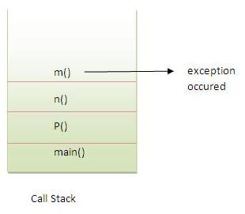
Exception Handling in Java
Java Exception propagation :
In the above example exception occurs in m() method where it is not handled,so it is propagated to previous n() method where it is not handled, again it is propagated to p() method where exception is handled.
Exception can be handled in any method in call stack either in main() method,p() method,n() method or m() method.

Slide 42
Exception Handling in Java
Java Exception propagation :
Rule: By default, Checked Exceptions are not forwarded in calling chain (propagated).
class TestExceptionPropagation2{
void m(){
throw new java.io.IOException("device error");//checked exception
}
void n(){
m();
}

Slide 43
Exception Handling in Java
Java Exception propagation :
void p(){
try{
n();
}catch(Exception e){System.out.println("exception handeled");}
}
public static void main(String args[]){
TestExceptionPropagation2 obj=new TestExceptionPropagation2();
obj.p();
System.out.println("normal flow"); }}
Output:Compile Time Error

Slide 44
Exception Handling in Java
Java throws keyword :
The Java throws keyword is used to declare an exception. It gives an information to the programmer that there may occur an exception so it is better for the programmer to provide the exception handling code so that normal flow can be maintained.
Exception Handling is mainly used to handle the checked exceptions. If there occurs any unchecked exception such as NullPointerException, it is programmers fault that he is not performing check up before the code being used.

Slide 45
Exception Handling in Java
Syntax of java throws :
return_type method_name() throws exception_class_name{
//method code
}
Which exception should be declared ?
Ans) checked exception only, because:
unchecked Exception: under your control so correct your code.
error: beyond your control e.g. you are unable to do anything if there occurs VirtualMachineError or StackOverflowError.

Slide 46
Exception Handling in Java
Advantage of Java throws keyword :
Now Checked Exception can be propagated (forwarded in call stack).
It provides information to the caller of the method about the exception.

Slide 47
Exception Handling in Java
Java throws example :
import java.io.IOException;
class Testthrows1{
void m()throws IOException{
throw new IOException("device error");//checked exception
}
void n()throws IOException{
m();
}
void p(){
try{ n();
}catch(Exception e)
{System.out.println("exception handled");}}

Slide 48
Exception Handling in Java
Java throws example :
public static void main(String args[]){
Testthrows1 obj=new Testthrows1();
obj.p();
System.out.println("normal flow...");
}
}
Output:
exception handled
normal flow...
Rule: If you are calling a method that declares an exception, you must either caught or declare the exception.

Slide 49
Exception Handling in Java
Java throws example :
There are two cases:
Case1:You caught the exception i.e. handle the exception using try/catch.
Case2:You declare the exception i.e. specifying throws with the method.

Slide 50
Exception Handling in Java
Case1: You handle the exception
import java.io.*;
class M{
void method()throws IOException{
throw new IOException("device error");
}
}
public class Testthrows2{
public static void main(String args[]){

Slide 51
Exception Handling in Java
Case1: You handle the exception
try{
M m=new M();
m.method();
}catch(Exception e){System.out.println("exception handled");}
System.out.println("normal flow...");
}
}
Output:exception handled
normal flow...

Slide 52
Exception Handling in Java
Case2: You declare the exception
In case you declare the exception, if exception does not occur, the code will be executed fine.
In case you declare the exception if exception occures, an exception will be thrown at runtime because throws does not handle the exception.

Slide 53
Exception Handling in Java
Program if exception does not occur
A)In case you declare the exception, if exception does not occur, the code will be executed fine.
B)In case you declare the exception if exception occures, an exception will be thrown at runtime because throws does not handle the exception.

Slide 54
Exception Handling in Java
A)Program if exception does not occur :
import java.io.*;
class M{
void method()throws IOException{
System.out.println("device operation performed");
}
}
class Testthrows3{
public static void main(String args[])throws IOException{
//declare exception
M m=new M();
m.method();
System.out.println("normal flow...");
} }

Slide 55
Exception Handling in Java
A)Program if exception does not occur :
Output:
device operation performed
normal flow...

Slide 56
Exception Handling in Java
B)Program if exception occurs :
import java.io.*;
class M{
void method()throws IOException{
throw new IOException("device error");
}
}
class Testthrows4{
public static void main(String args[])throws IOException{
//declare exception
M m=new M();
m.method();
System.out.println("normal flow...");
} }

Slide 57
Exception Handling in Java
B)Program if exception occurs :
import java.io.*;
class M{
void method()throws IOException{
throw new IOException("device error");
}}
class Testthrows4{
public static void main(String args[])throws IOException{
//declare exception
M m=new M();
m.method();
System.out.println("normal flow...");
} }
Output:Runtime Exception

Slide 58
Exception Handling in Java
Can we rethrow an exception ?
Yes, by throwing same exception in catch block.

Slide 59
Exception Handling in Java
Difference between throw and throws in Java
No. | throw | throws
1) | Java throw keyword is used to explicitly throw an exception. | Java throws keyword is used to declare an exception.
2) | Checked exception cannot be propagated using throw only. | Checked exception can be propagated with throws.
3) | Throw is followed by an instance. | Throws is followed by class.
4) | Throw is used within the method. | Throws is used with the method signature.
5) | You cannot throw multiple exceptions. | You can declare multiple exceptions e.g. public void method()throws IOException,SQLException

Slide 60
Exception Handling in Java
Difference between final, finally and finalize
No. | final | finally | finalize
1) | Final is used to apply restrictions on class, method and variable. Final class can't be inherited, final method can't be overridden and final variable value can't be changed. | Finally is used to place important code, it will be executed whether exception is handled or not. | Finalize is used to perform clean up processing just before object is garbage collected.
2) | Final is a keyword. | Finally is a block. | Finalize is a method

Slide 61
Exception Handling in Java
Java finalize example :
class FinalizeExample{
public void finalize(){System.out.println("finalize called");}
public static void main(String[] args){
FinalizeExample f1=new FinalizeExample();
FinalizeExample f2=new FinalizeExample();
f1=null;
f2=null;
System.gc();
}}

Slide 62
Exception Handling in Java
ExceptionHandling with MethodOverriding in Java
There are many rules if we talk about methodoverriding with exception handling. The Rules are as follows:
If the superclass method does not declare an exception, subclass overridden method cannot declare the checked exception but it can declare unchecked exception.
If the superclass method declares an exception, subclass overridden method can declare same, subclass exception or no exception but cannot declare parent exception.

Slide 63
Exception Handling in Java
1) Rule: If the superclass method does not declare an exception, subclass overridden method cannot declare the checked exception.
import java.io.*;
class Parent{
void msg(){System.out.println("parent");}
}
class TestExceptionChild extends Parent{
void msg()throws IOException{
System.out.println("TestExceptionChild");
}

Slide 64
Exception Handling in Java
1) Rule: If the superclass method does not declare an exception, subclass overridden method cannot declare the checked exception.
public static void main(String args[]){
Parent p=new TestExceptionChild();
p.msg();
}
}
Output:Compile Time Error

Slide 65
Exception Handling in Java
2) Rule: If the superclass method does not declare an exception, subclass overridden method cannot declare the checked exception but can declare unchecked exception.
import java.io.*;
class Parent{
void msg(){System.out.println("parent");}
}
class TestExceptionChild1 extends Parent{
void msg()throws ArithmeticException{
System.out.println("child");
}

Slide 66
Exception Handling in Java
2) Rule: If the superclass method does not declare an exception, subclass overridden method cannot declare the checked exception but can declare unchecked exception.
public static void main(String args[]){
Parent p=new TestExceptionChild1();
p.msg();
}
}
Output:child

Slide 67
Exception Handling in Java
3) Rule: If the superclass method declares an exception, subclass overridden method can declare same, subclass exception or no exception but cannot declare parent exception.
//Example in case subclass overridden method declares parent exception
import java.io.*;
class Parent{
void msg()throws ArithmeticException{System.out.println("parent");}
}
class TestExceptionChild2 extends Parent{
void msg()throws Exception{System.out.println("child");}

Slide 68
Exception Handling in Java
3) Rule: If the superclass method declares an exception, subclass overridden method can declare same, subclass exception or no exception but cannot declare parent exception.
//Example in case subclass overridden method declares parent exception
public static void main(String args[]){
Parent p=new TestExceptionChild2();
try{
p.msg();
}catch(Exception e){}
} }
Output:Compile Time Error

Slide 69
Exception Handling in Java
3) Rule: If the superclass method declares an exception, subclass overridden method can declare same, subclass exception or no exception but cannot declare parent exception.
//Example in case subclass overridden method declares same exception
import java.io.*;
class Parent{
void msg()throws Exception{System.out.println("parent");}
}
class TestExceptionChild3 extends Parent{
void msg()throws Exception{System.out.println("child");}

Slide 70
Exception Handling in Java
3) Rule: If the superclass method declares an exception, subclass overridden method can declare same, subclass exception or no exception but cannot declare parent exception.
//Example in case subclass overridden method declares same exception
public static void main(String args[]){
Parent p=new TestExceptionChild3();
try{
p.msg();
}catch(Exception e){}
} }
Output:child

Slide 71
Exception Handling in Java
3) Rule: If the superclass method declares an exception, subclass overridden method can declare same, subclass exception or no exception but cannot declare parent exception.
//Example in case subclass overridden method declares subclass exception
import java.io.*;
class Parent{
void msg()throws Exception{System.out.println("parent");} }
class TestExceptionChild4 extends Parent{
void msg()throws ArithmeticException{System.out.println("child");}

Slide 72
Exception Handling in Java
3) Rule: If the superclass method declares an exception, subclass overridden method can declare same, subclass exception or no exception but cannot declare parent exception.
//Example in case subclass overridden method declares subclass exception
public static void main(String args[]){
Parent p=new TestExceptionChild4();
try{
p.msg();
}catch(Exception e){}
} }
Output:child

Slide 73
Exception Handling in Java
3) Rule: If the superclass method declares an exception, subclass overridden method can declare same, subclass exception or no exception but cannot declare parent exception.
//Example in case subclass overridden method declares no exception
import java.io.*;
class Parent{
void msg()throws Exception{System.out.println("parent");}
}
class TestExceptionChild5 extends Parent{
void msg(){System.out.println("child");}

Slide 74
Exception Handling in Java
3) Rule: If the superclass method declares an exception, subclass overridden method can declare same, subclass exception or no exception but cannot declare parent exception.
//Example in case subclass overridden method declares no exception
public static void main(String args[]){
Parent p=new TestExceptionChild5();
try{
p.msg();
}catch(Exception e){}
} }
Output:child

Slide 75
Exception Handling in Java
Java Custom Exception
If you are creating your own Exception that is known as custom exception or user-defined exception. Java custom exceptions are used to customize the exception according to user need.
By the help of custom exception, you can have your own exception and message.

Slide 76
Exception Handling in Java
Java Custom Exception Example
class InvalidAgeException extends Exception{
InvalidAgeException(String s){
super(s);
} }
class TestCustomException1{
static void validate(int age)throws InvalidAgeException{
if(age<18)
throw new InvalidAgeException("not valid");
else
System.out.println("welcome to vote");
}

Slide 77
Exception Handling in Java
Java Custom Exception Example
public static void main(String args[]){
try{
validate(13);
}catch(Exception m){System.out.println("Exception occured: "+m);}
System.out.println("rest of the code...");
}
}
Output:Exception occured: InvalidAgeException:not valid
rest of the code...

